Slide 1
Facilitator Guide
Embed Modes
Version 1.0
Last modified by Mike Burns 2022-05-11

Slide 2
Contents
Facilitators Guide to Running a Embed Mode

Slide 3
Overview

Slide 4
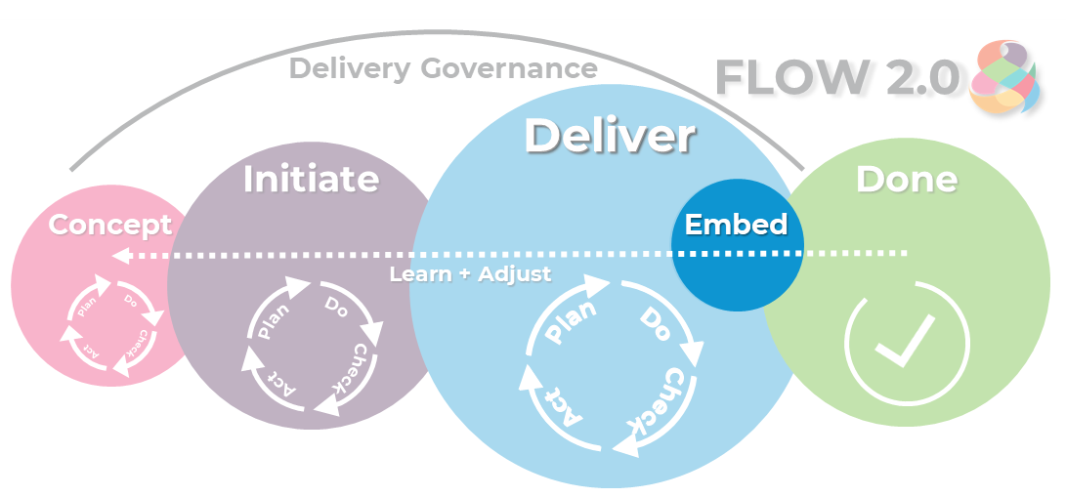
Objective
To

Slide 5
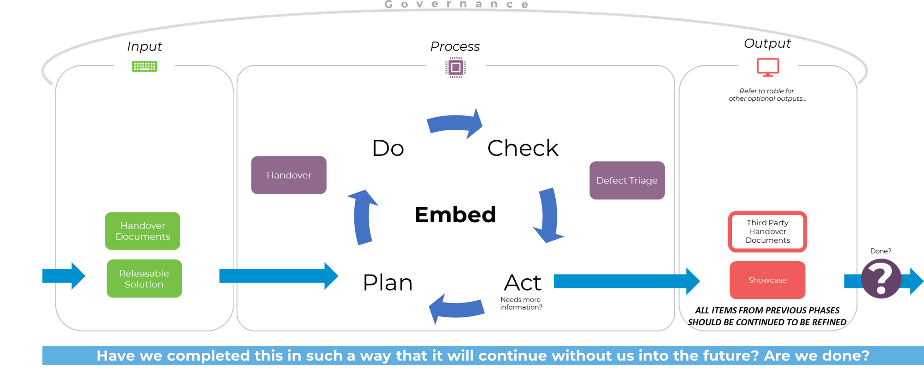

Slide 6
Consider the Context

Slide 7
Process
Delivery team/s will be engaged more in the detail of the change, and will elaborate and break up work into right-sized chunks.

Slide 8
Approach
Embed is our warranty and handover
Have we completed this in such a way that it will continue without us into the future?
Are we done?
Once the solution is released to production, there may be post-production issues. If an issue is encountered in the production the development team must have a process to handle defects and new features.
Once deployed we make sure that things will work into the future when we are not around by helping support teams embed the solution.

Slide 9
Who is involved?
Product Manager
Project Manager
Scrum Master
Change Manager
Configuration Item Manager (CIM)
Support Teams

Slide 10

Inner Phases
The inner thinking modes of concept may have to be visited multiple times to achieve the outputs and outcomes required to get approval to move forward.
These thinking modes are used to group activities within the concept mode.
We start by discovering what the problem is, the we can identify the work. We can analyse cost/benefits and come up with different options. From here we can present the options to make decisions about what to do next .
During each inner mode you still should plan what you are going to do, perform it, check that it got the results, and choice your next action.
This is why Flow 2.0 is an agile methodology – it uses agile techniques itself!
Handover
Defect Management
Deliverables

Slide 11
Outputs

Slide 12
Deliverables

Slide 13
Supporting Tools and Techniques
Examples of tools and techniques to support you during the Initiate workshop, and throughout Initiate phase.

Slide 14
Tools –

